Slide 1
Fundamentals of Machine Learning

Slide 2
Overview
Learning Algorithms
Capacity, Overfitting, and Underfitting
Hyperparameters, Training, Testing and Validation
Maximum Likelihood Estimation

Slide 3
Books on machine learning
https://www.microsoft.com/en-us/research/uploads/prod/2006/01/Bishop-Pattern-Recognition-and-Machine-Learning-2006.pdf
https://www.cs.ubc.ca/~murphyk/MLbook/

Slide 4
Learning Algorithms
Different type of algorithms than algorithms courses cover
i.e. search, sort, graph traversal
“A computer program is said to learn from experience E with respect to some class of tasks T and performance measure P, if its performance at T as measured by P improves with E.”
Mitchell, T. M. (1997). Machine Learning. McGraw-Hill, New York.
In most cases, do not guarantee an optimal solution, runtime, performance, etc

Slide 5
Learning Algorithms
“A computer program is said to learn from experience E with respect to some class of tasks T and performance measure P, if its performance at T as measured by P improves with E.”
T – something we would like to predict
Price of house sale, likelihood a customer will leave HBO streaming, etc
E – generally collected data relevant to T
How big is the house, was the customer only watching game of thrones?
P – accuracy, error between predicted and actual value
Sale price – predicted price, did the customer actually churn?

Slide 6
Tasks
Primary tasks
Classification – Discrete outcomes
Regression – Continuous outcomes
Other types of tasks
Denoising
Translation
Density Estimation
Anomaly Detection
Imputation of missing values
Clustering

Slide 7
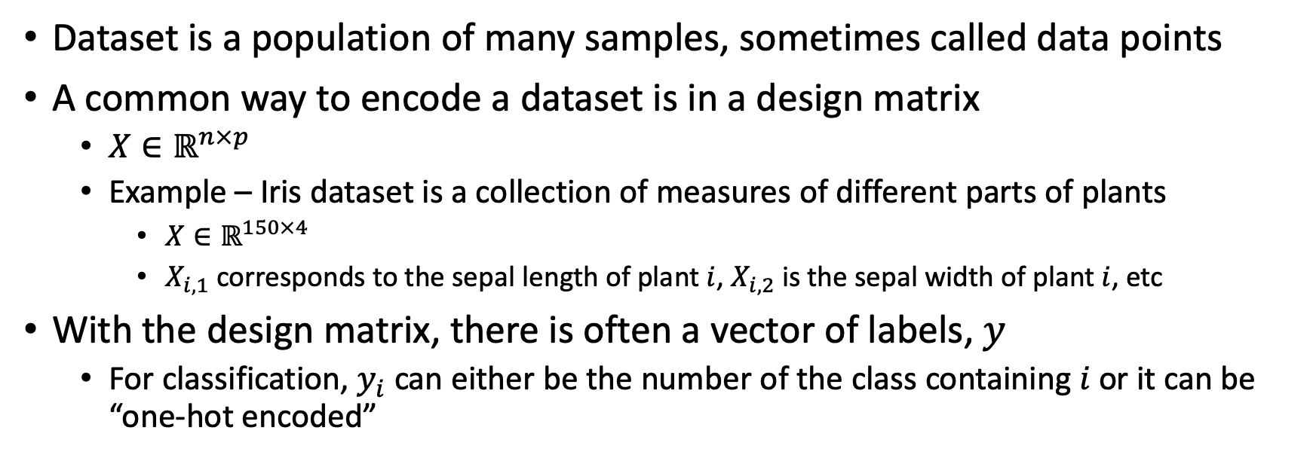
Experience
Dataset is a population of many samples, sometimes called data points
A common way to encode a dataset is in a design matrix
$X∈ℝ^{n×p}$
Example – Iris dataset is a collection of measures of different parts of plants
$X∈ℝ^{150×4}$
$X_{i,1}$ corresponds to the sepal length of plant $i$, $X_{i,2}$ is the sepal width of plant $i$, etc
With the design matrix, there is often a vector of labels, $y$
For classification, $y_{i}$ can either be the number of the class containing $i$ or it can be “one-hot encoded”

Slide 8
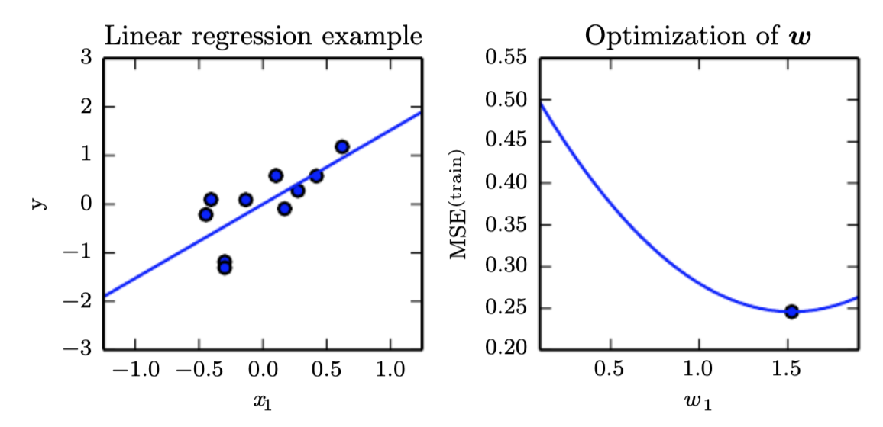
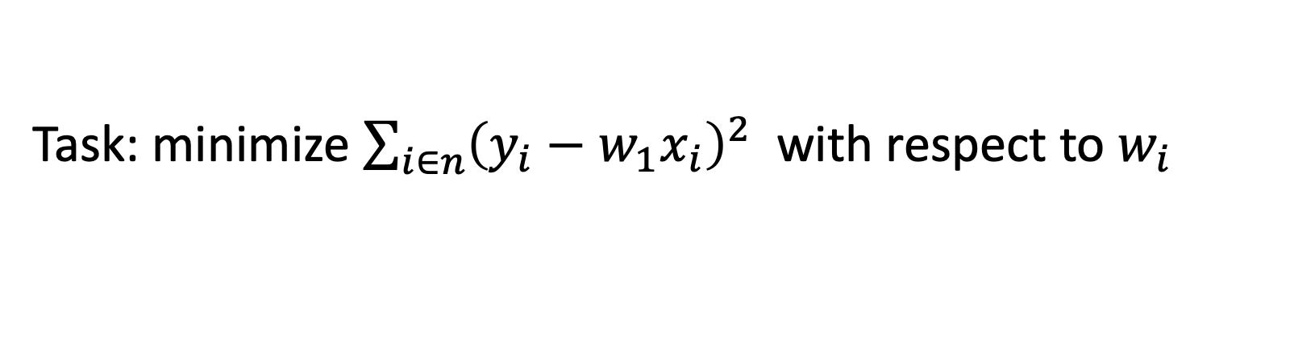
Example: Linear Regression
Task: minimize $\sum_{i∈n}{{\left(y_{i}−w_{1}x_{i}\right)}^{2}}$ with respect to $w_{i}$

Slide 9
Capacity, Overfitting, and Underfitting
Any machine learning algorithm must perform well on new, unseen inputs
A common problem is over or underfitting a model
Overfitting is a model fitting the training data too closely to the data
Underfitting is a model not fitting the data enough

Slide 10
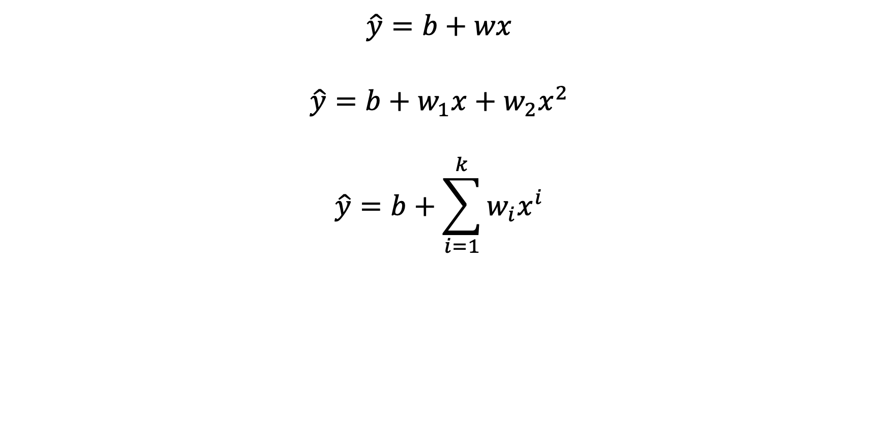
Example: Linear Regression
$$\hat{y}=b+wx$$
$$\hat{y}=b+w_{1}x+w_{2}x^{2}$$
$$\hat{y}=b+\sum_{i=1}^{k}{w_{i}x^{i}}$$

Slide 11
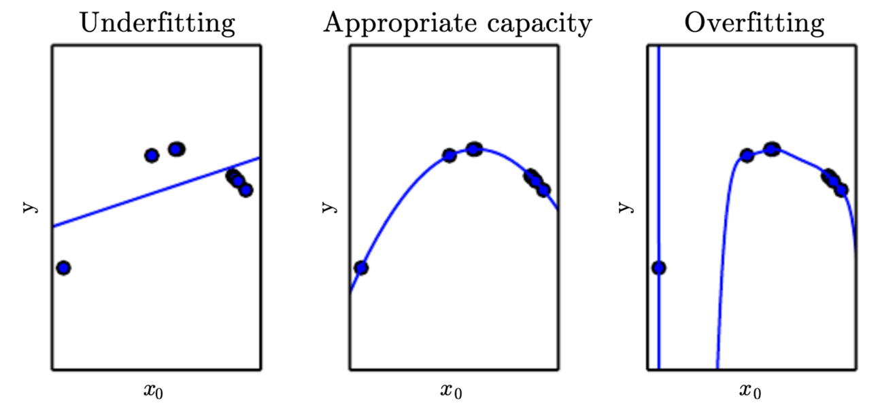
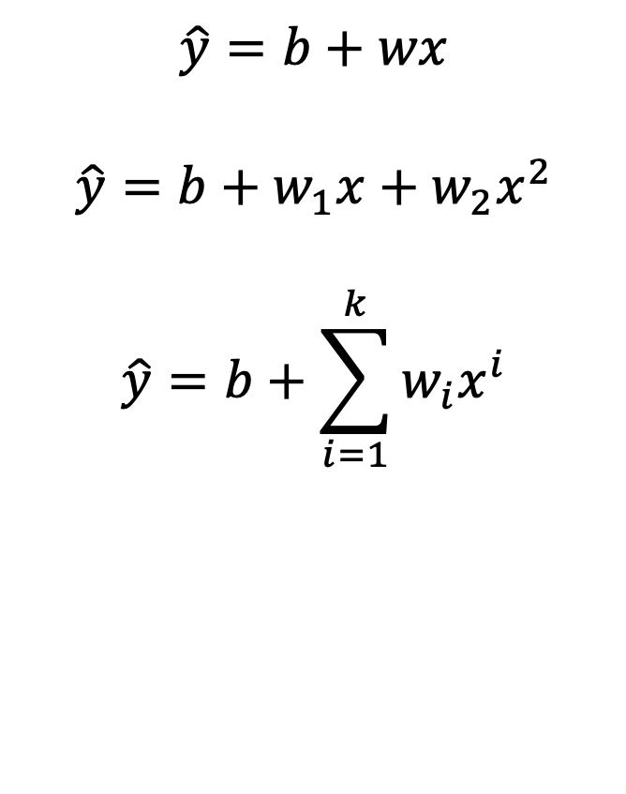
Example: Linear Regression
$$\hat{y}=b+wx$$
$$\hat{y}=b+w_{1}x+w_{2}x^{2}$$
$$\hat{y}=b+\sum_{i=1}^{k}{w_{i}x^{i}}$$

Slide 12
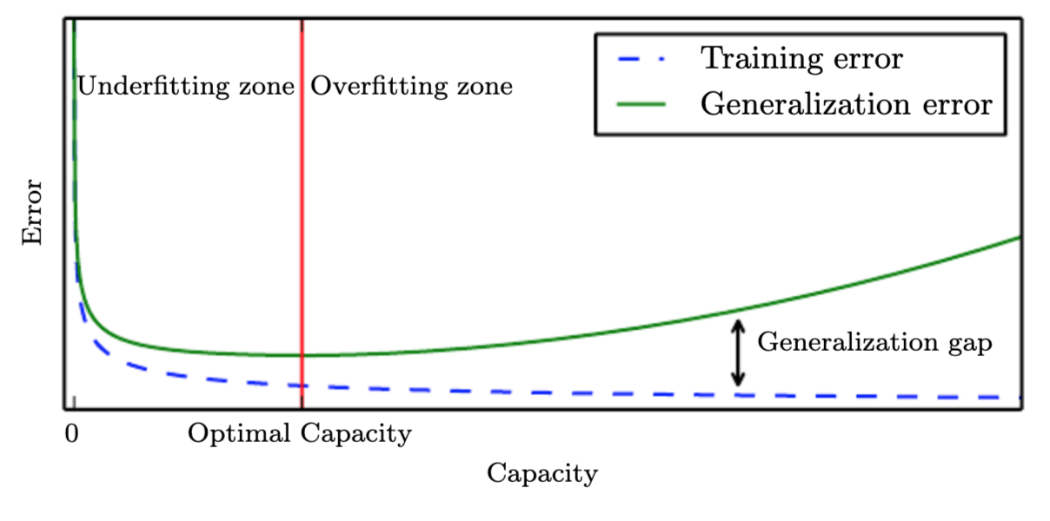
Training data
The data collected (experience) is known as training data
Model is typically built off of the training data

Slide 13
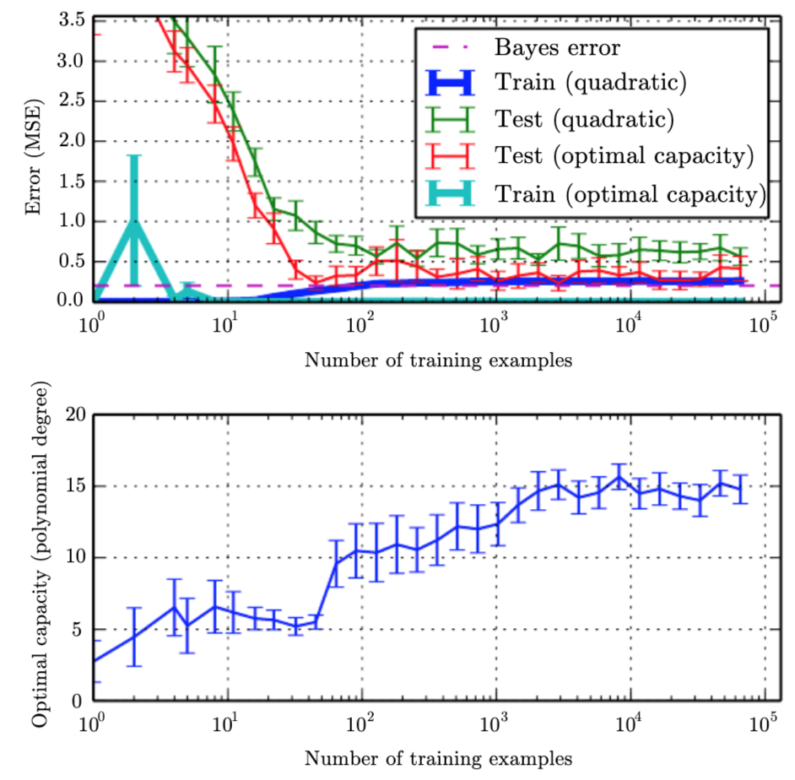
Training Data
Training – Used to build the model
Testing – Used to validate the model and used to compare model types
Validation – Report on the final prediction results
Typical split is 70/20/10
Notes:
The eﬀect of the training dataset size on the train and test error, as well as
on the optimal model capacity. We constructed a synthetic regression problem based on
adding a moderate amount of noise to a degree-5 polynomial, generated a single test set,
and then generated several diﬀerent sizes of training set. For each size, we generated 40
diﬀerent training sets in order to plot error bars showing 95 percent conﬁdence intervals.
(Top)The MSE on the training and test set for two diﬀerent models: a quadratic model,
and a model with degree chosen to minimize the test error. Both are ﬁt in closed form. For
the quadratic model, the training error increases as the size of the training set increases.
This is because larger datasets are harder to ﬁt. Simultaneously, the test error decreases,
because fewer incorrect hypotheses are consistent with the training data. The quadratic
model does not have enough capacity to solve the task, so its test error asymptotes to
a high value. The test error at optimal capacity asymptotes to the Bayes error. The
training error can fall below the Bayes error, due to the ability of the training algorithm
to memorize speciﬁc instances of the training set. As the training size increases to inﬁnity,
the training error of any ﬁxed-capacity model (here, the quadratic model) must rise to at
least the Bayes error. (Bottom)As the training set size increases, the optimal capacity
(shown here as the degree of the optimal polynomial regressor) increases. The optimal
capacity plateaus after reaching suﬃcient complexity to solve the task

Slide 14
No Free Lunch Theorum
Learning theory claims that a machine learning algorithm can generalize well from a ﬁnite training set of examples.
The no free lunch theorem for machine learning states that, averaged over all possible data-generating distributions, every classiﬁcation algorithm has the same error rate when classifying previously unobserved points.
These results hold only when we average over all possible data-generating distributions. If we make assumptions about the kinds of probability distributions we encounter in real-world applications, then we can design learning algorithms that perform well on these distributions.
The goal of machine learning research is not to seek a universal learning algorithm or the absolute best learning algorithm. Instead, our goal is to understand what kinds of distributions are relevant to the “real world” that an AI agent experiences, and what kinds of machine learning algorithms perform well on data drawn from the kinds of data-generating distributions we care about.
Wolpert, D. H. (1996). The lack of a priori distinction between learning algorithms. Neural Computation, 8(7), 1341–1390

Slide 15
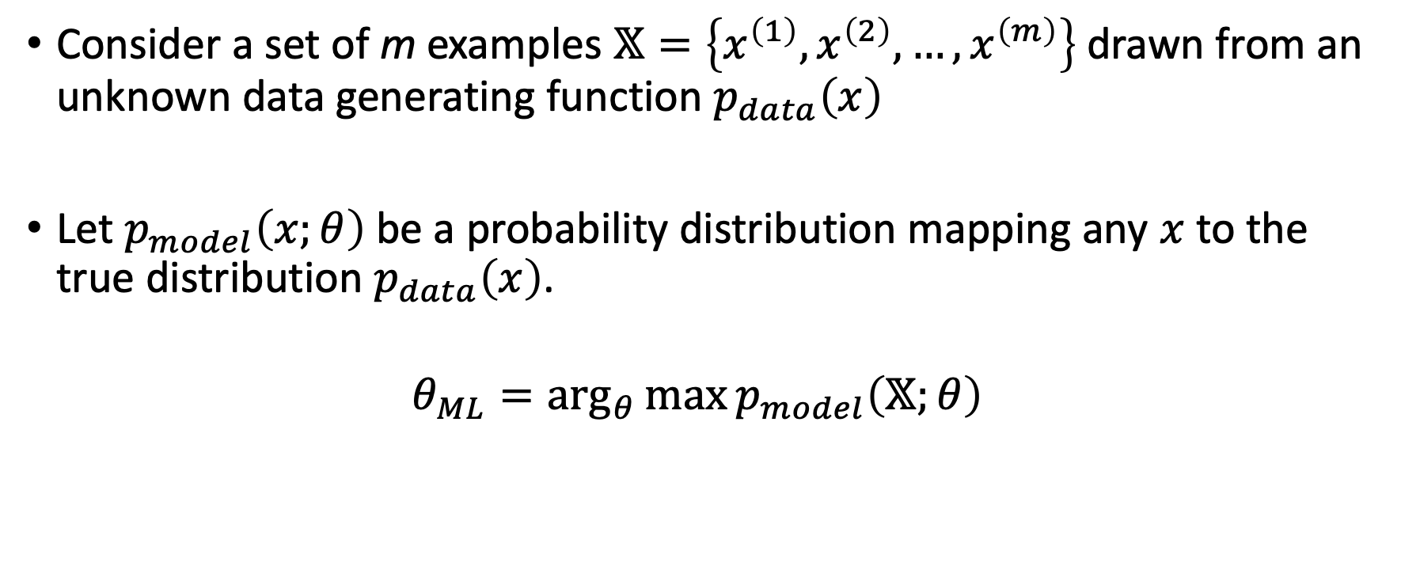
Maximum Likelihood Estimation
Consider a set of m examples $𝕏=\left\{x^{\left(1\right)}, x^{\left(2\right)},…, x^{\left(m\right)}\right\}$ drawn from an unknown data generating function $p_{data}\left(x\right)$
Let $p_{model}\left(x;θ\right)$ be a probability distribution mapping any $x$ to the true distribution $p_{data}\left(x\right)$.
$$θ_{ML}=\arg_{θ}{\max{p_{model}\left(𝕏;θ\right)}}$$

Slide 16
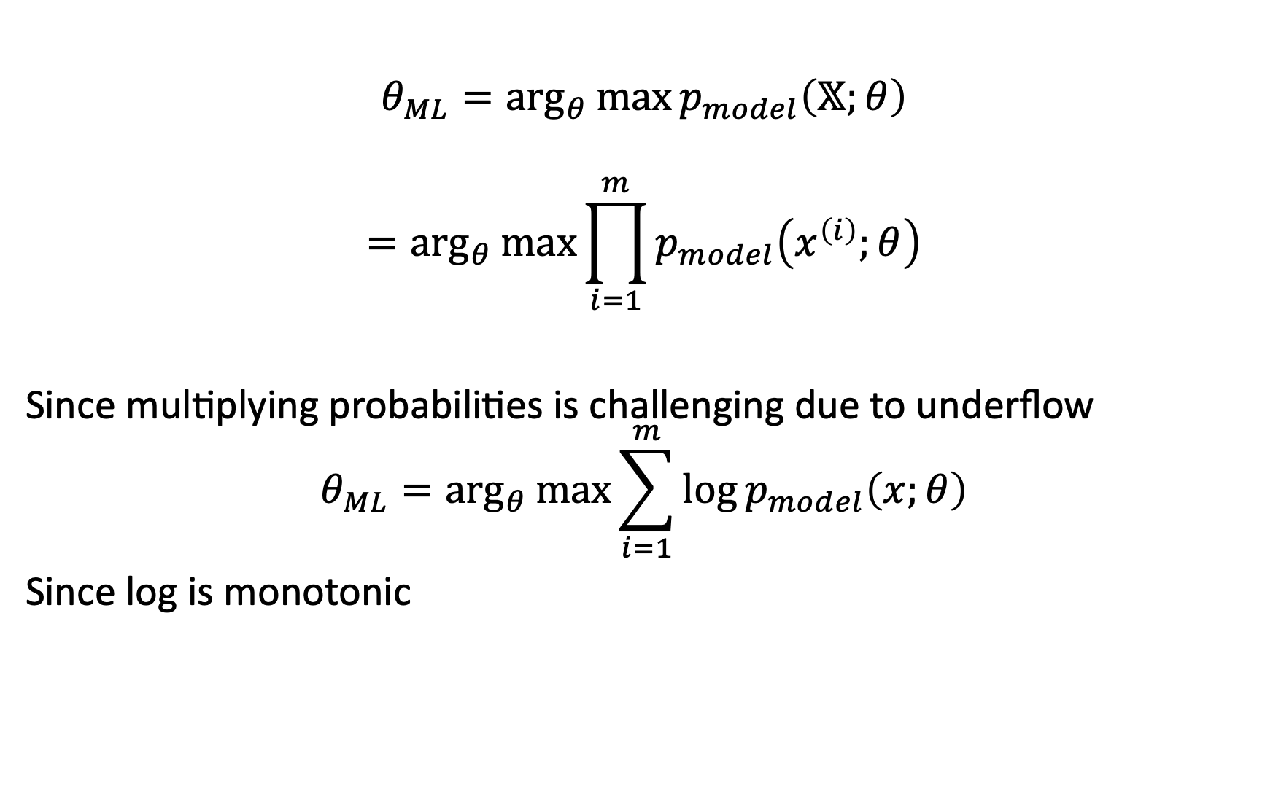
Maximum Likelihood Estimation
$$θ_{ML}=\arg_{θ}{\max{p_{model}\left(𝕏;θ\right)}}$$
$$=\arg_{θ}{\max{\prod_{i=1}^{m}{p_{model}\left(x^{\left(i\right)};θ\right)}}}$$
Since multiplying probabilities is challenging due to underflow
$$θ_{ML}=\arg_{θ}{\max{\sum_{i=1}^{m}{\log{p_{model}\left(x;θ\right)}}}}$$
Since log is monotonic

Slide 17
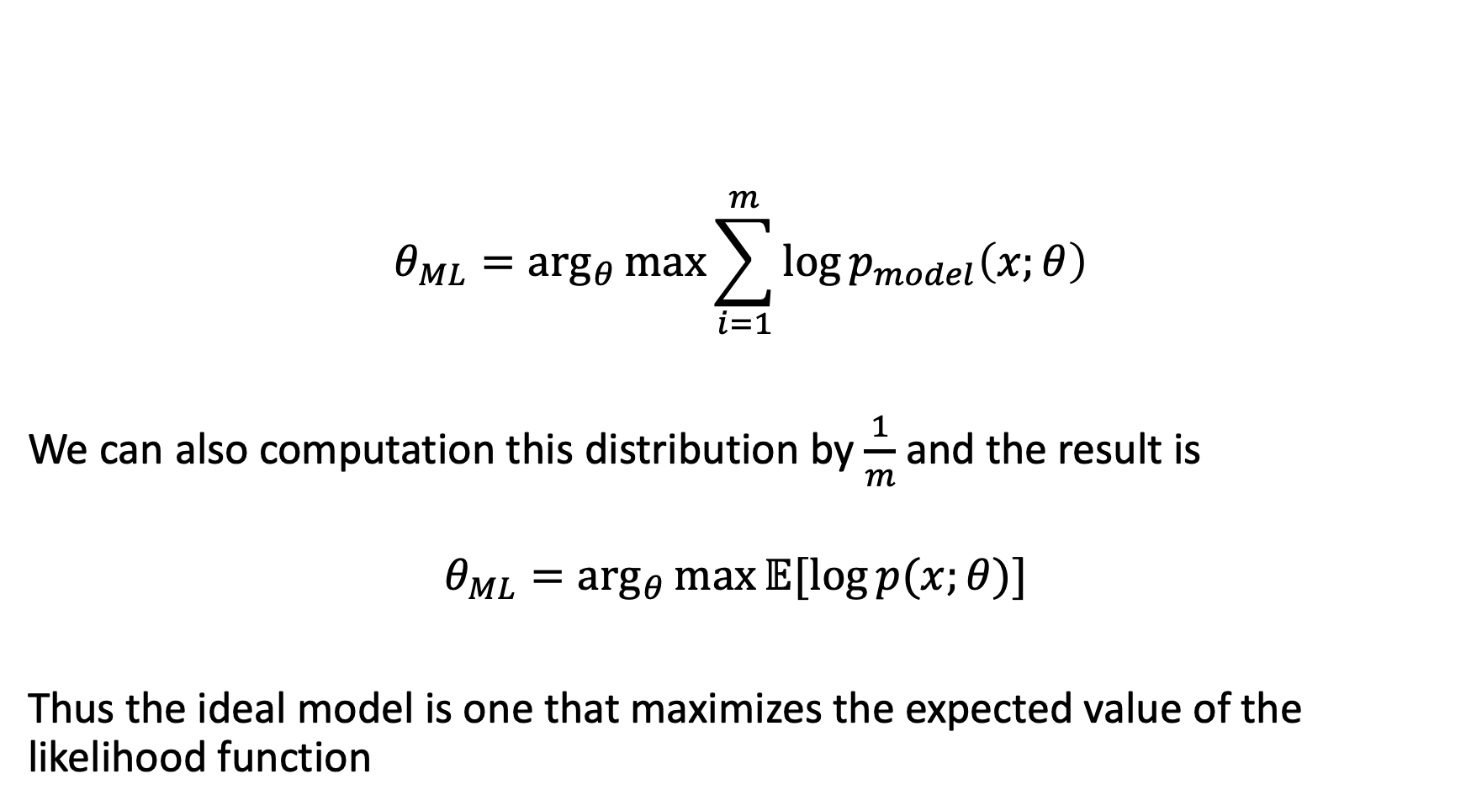
Maximum Likelihood Estimation
$$θ_{ML}=\arg_{θ}{\max{\sum_{i=1}^{m}{\log{p_{model}\left(x;θ\right)}}}}$$
We can also computation this distribution by $\frac{1}{m}$ and the result is
$$θ_{ML}=\arg_{θ}{\max{𝔼[\log{p(x;θ)] }}}$$
Thus the ideal model is one that maximizes the expected value of the likelihood function

Slide 18
Other machine learning algorithms
Support Vector Machines
Logistic/Linear Regression
Decision Trees
Tree Ensembles
Random Forests
XGBoost
K-Means Clustering
Principal Component Analysis

